Slide 1
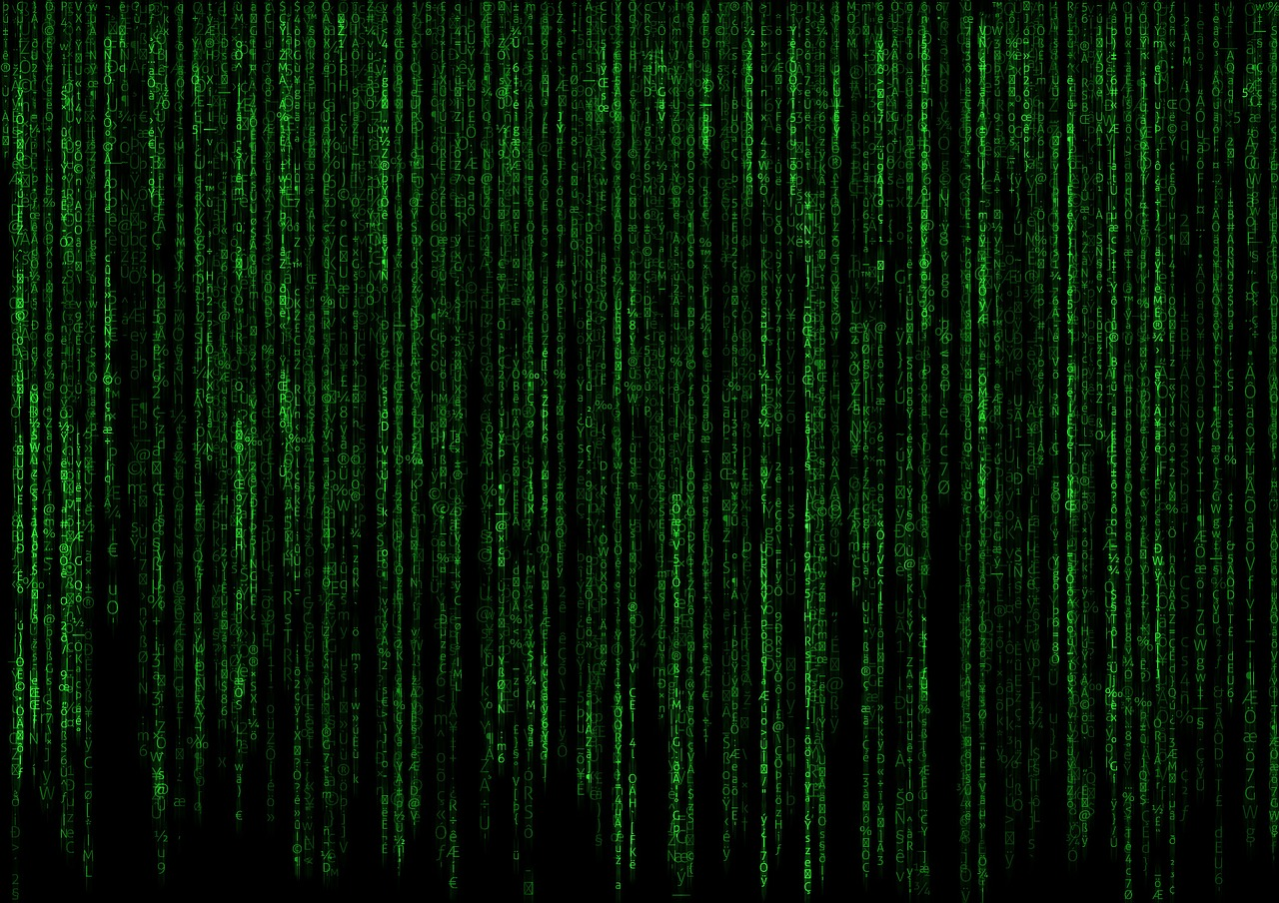

Introduction to APIs
Tim Benroeck timRND.com | @TimBenroeck

Slide 2
Application Programming Interface
API

Slide 3

An API expresses a software component in terms of its operations, inputs, outputs, and underlying types.
An API defines functionalities that are independent of their respective implementations, which allows definitions and implementations to vary without compromising each other.
A good API makes it easier to develop a program by providing all the building blocks. A programmer then puts the blocks together.
- wikipedia
Application Programming Interface

Slide 4


APIs let applications talk to each other

Slide 5

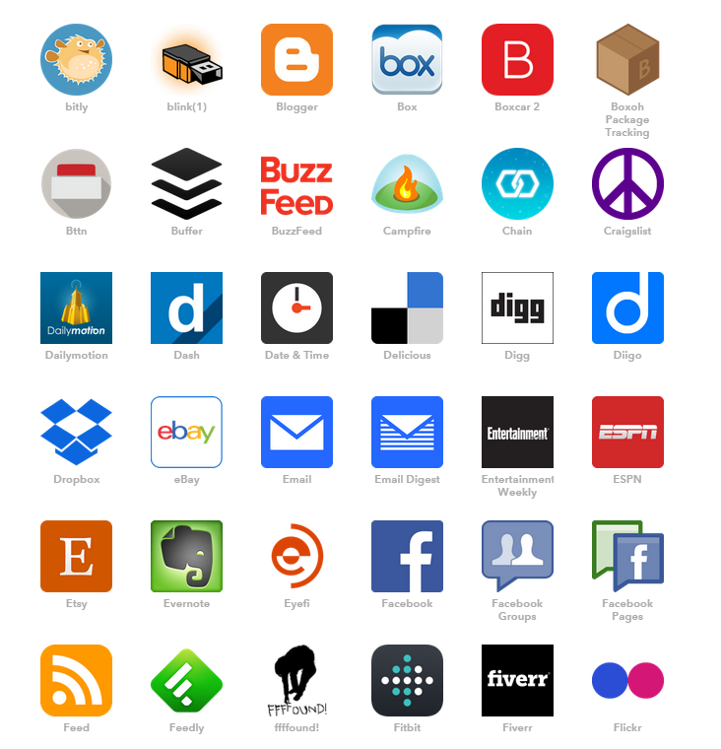
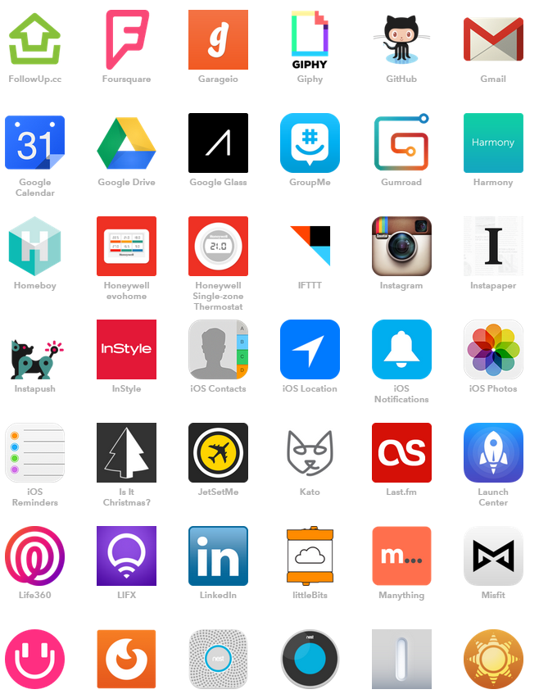
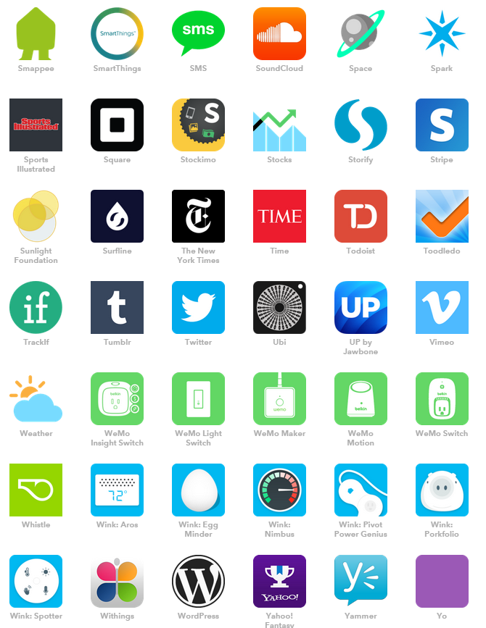
APIs let applications talk to each other
IF This Than That (IFTTT.COM)

Slide 6
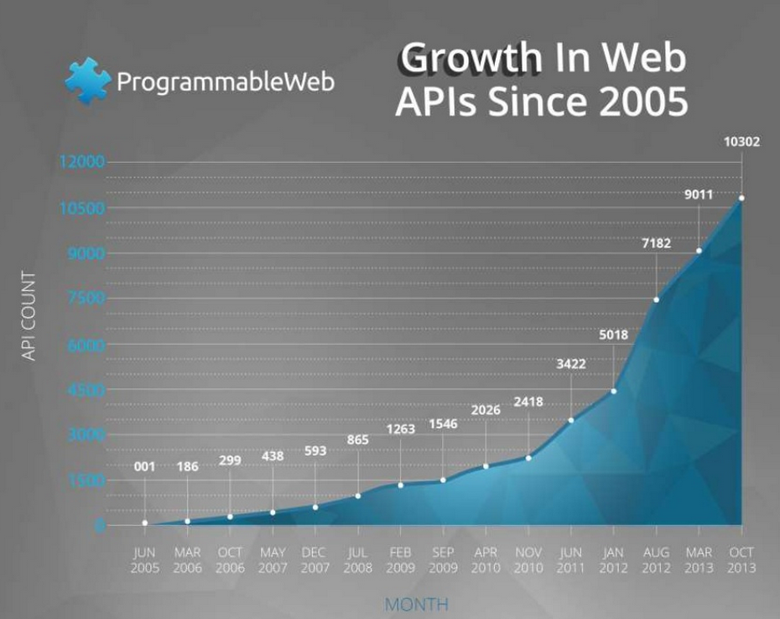
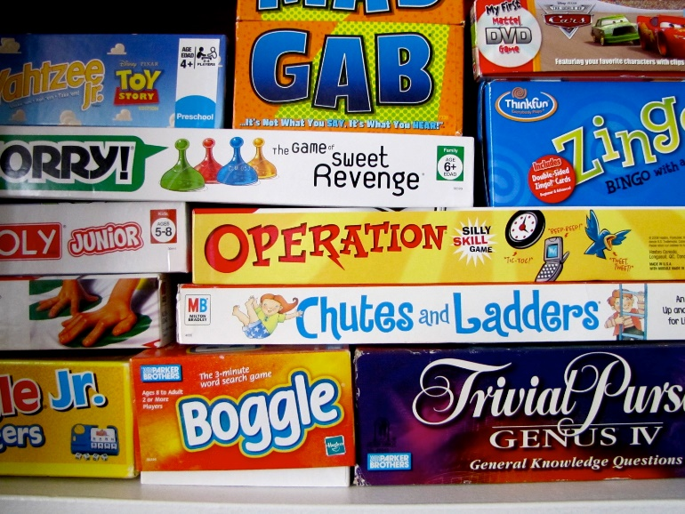

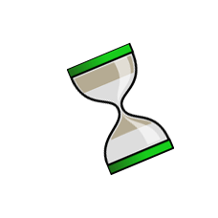
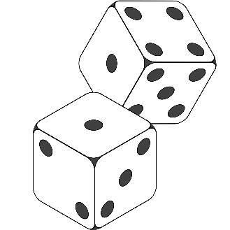

Slide 7
</>
DEMO

Slide 8
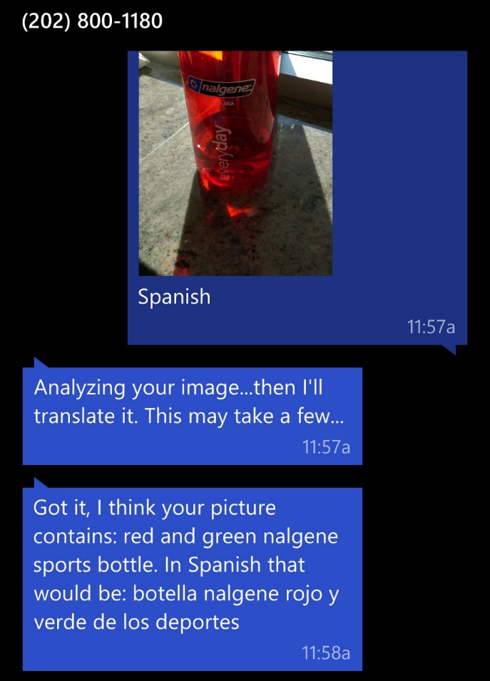
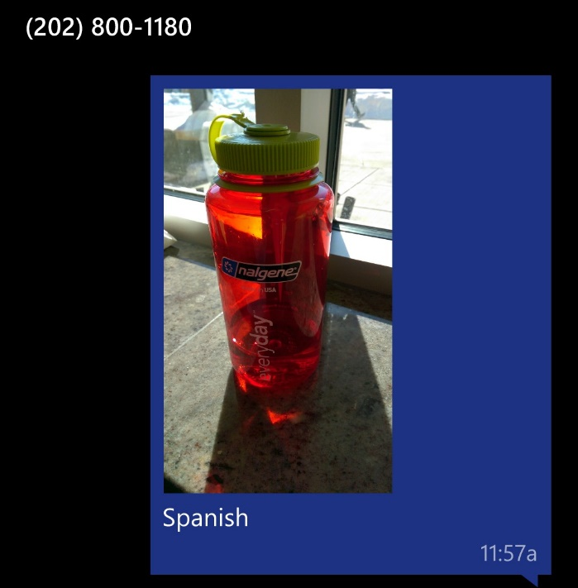
Text a picture to
(202) 800-1180
(include a language)

Slide 9






Slide 10
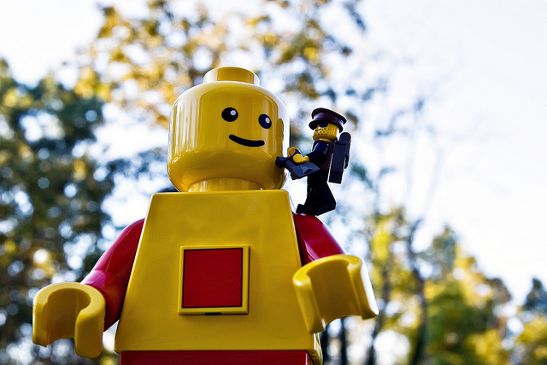
Stand on the shoulders of giants

Slide 11
Stand on the shoulders of giants

Slide 12
Representational State Transfer
REST

Slide 13
Representational state transfer (REST) is an abstraction of the architecture of the World Wide Web.
REST is an architectural style consisting of a coordinated set of architectural constraints applied to components, connectors, and data elements, within a distributed hypermedia system.
- wikipedia
Representational State Transfer

Slide 14
HTTP Verbs
GET
POST
DELETE
PUT
PATCH

Slide 15

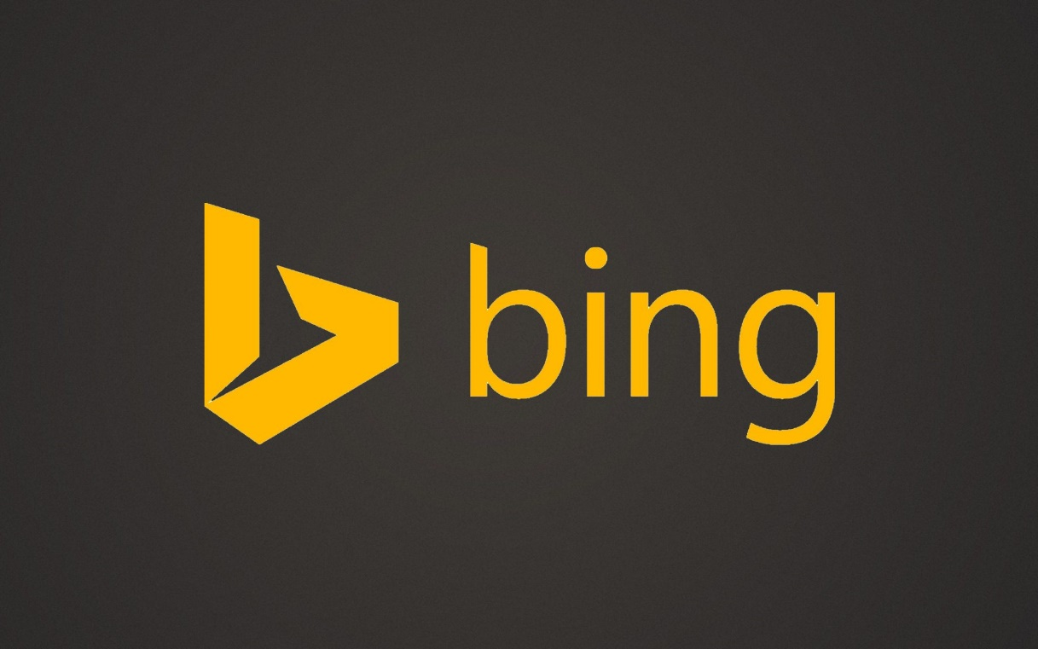





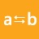

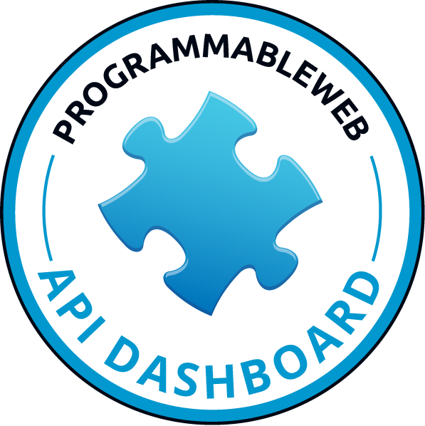

REST APIs
Maps
Speech
Translator
Search
Synonyms
docs.mashape.com
dev.bing.com
developer.nytimes.com
programmableweb.com/apis

Slide 16
Software Development Kit
SDK

Slide 17
Weather API
</>
DEMO

Slide 18
API Communications

Slide 19
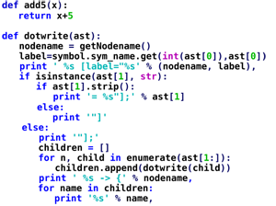
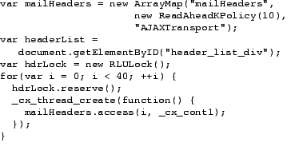
Huh?

Slide 20
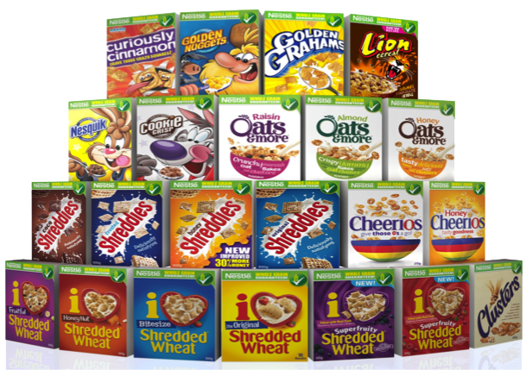
Serialization

Slide 21
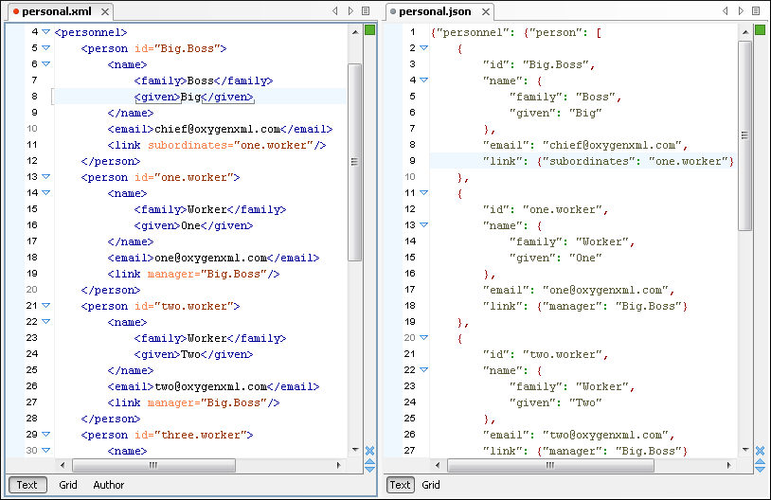
XML
JSON

Slide 22
JSON

Slide 23
Weather App
</>
DEMO

Slide 24
Polling
API Patterns

Slide 25
API Pattern: Polling
Any new data?
Nope

Slide 26
API Pattern: Polling
How about now?
Ahh ..Nope

Slide 27
API Pattern: Polling
Now?
No!

Slide 28
API Pattern: Polling
Sorry to bother you … but how about now?
Man! … really!?

Slide 29
Webhook
API Patterns

Slide 30
API Pattern: Webhook
Hey let me know when you get some data
for me
Sounds Good!
Yo … Check it!

Slide 31
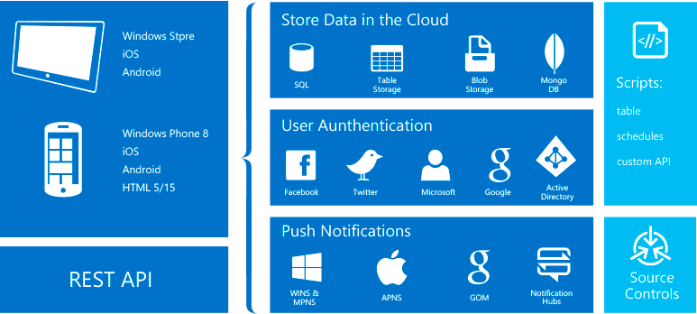

Slide 32
Twilio API
</>
DEMO

Slide 33
Streaming
API Patterns

Slide 34

API Pattern: Streaming

Slide 35
Twitter API
</>
DEMO

Slide 36
Questions?

